Slide 1
Comprehensive SDLC Playbook
Middleware
15-Jul-25

Slide 2





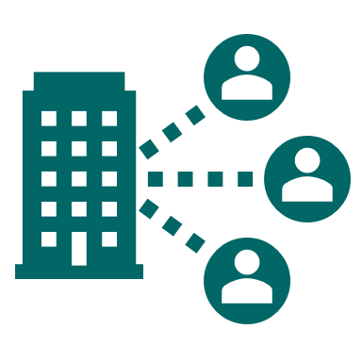


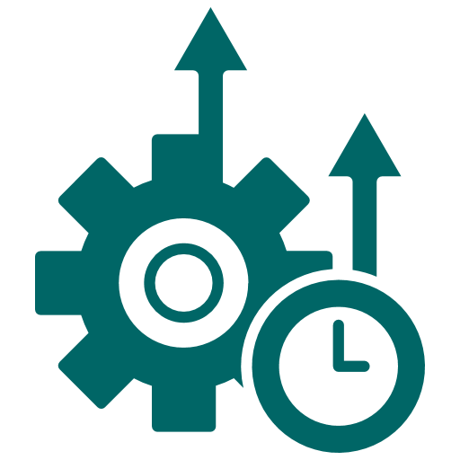


Key Objectives
Key objectives of Playbook
Streamline Project Execution
Provide a structured framework for managing the SDLC of Middleware projects, ensuring consistent and efficient workflows
Simplify Decision Making
Provide clear guidance on selecting the right tools, frameworks, libraries, and architectural patterns like Microservices or MVC to enhance development efficiency and scalability
Define Clear Entry and Exit Criteria
Establish clear prerequisites and deliverables for each phase to ensure alignment and reduce the risk of Regression during the development process
Mitigate Risks
Identify and address potential issues early through risk assessment, debugging, and performance monitoring strategies
Enhance Collaboration
Encourage open communication and collaboration between stakeholders, developers, and QA teams through well-defined processes and regular touchpoints
Optimize Time and Resources
Create a timeline with realistic milestones and ensure efficient use of development resources
Ensure Quality Deliverables
Focus on meeting functional and non-functional requirements by incorporating testing and validation at every stage
Enable Continuous Improvement
Incorporate feedback mechanisms for iterative enhancements and post-deployment updates
Support Scalability and Maintainability
By implementing robust design principles and development strategies, ensuring the application can adapt to growing demands and remain efficient over time
Standardize Best Practices
Serve as a reference guide for adopting industry-standard methods and practices across all projects

Slide 3




SDLC Key Scope
SDLC Key Scope
Target Audience
Development teams, quality assurance engineers, project managers, and operations teams responsible for API development and maintenance.
Lifecycle Stages
Detailed processes for each phase of the SDLC, including requirements gathering, system design, implementation, testing, deployment, and maintenance.
Security and Compliance
Establishes measures to ensure APIs adhere to security protocols, data protection standards, and compliance with industry regulations.
Scalability Across Platforms
Middleware responsibilities include providing reliability, scalability, and transactional consistency across systems, while excluding user interface design or business logic implementation.

Slide 4

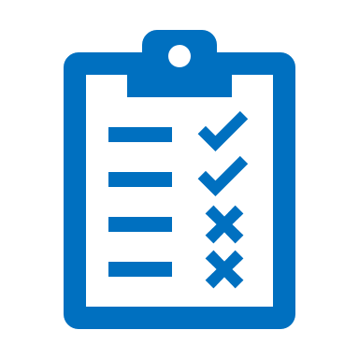



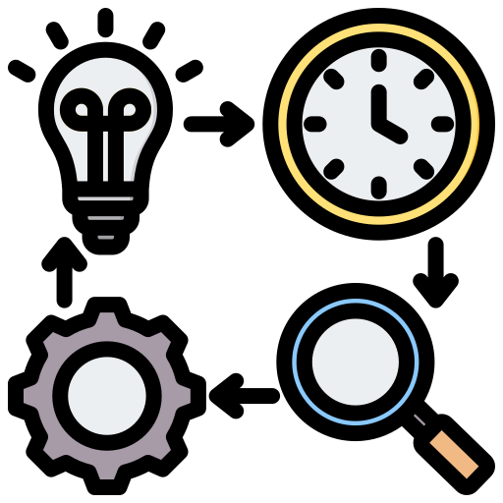


SDLC Phases
Software Development Life Cycle (SDLC)
The Software Development Life Cycle is a structured process used to design, develop, test, and maintain software systems. It ensures the efficient delivery of high-quality solutions that align with business objectives.
Write and integrate the code as per the design specifications
Design the architecture and visual aspects of the application
Create a blueprint of the system architecture, components, and interfaces​
04
Validate the system by identifying and fixing defects to ensure it meets requirements
Development
03
05
Design
Testing
Deploying the developed and tested software to the production environment, making it accessible to end-users
Define the project scope, objectives, and feasibility to align with business goals
06
02
Planning
Deployment
Analyze and finalize application requirements based on the Business Requirements Document
01
07
Ensure the application remains functional and updated post-deployment
Requirement
Maintenance

Slide 5
Phase 01 - Requirement

Slide 6





SDLC Requirement Phase
What happens in Requirement Phase?
The Requirements Gathering Stage of Middleware defines the business and technical needs for seamless frontend-backend communication, incorporating the perspectives of key stakeholders. It ensures that their requirements for secure data exchange, efficient API management, and integration are met, all while aligning with organizational goals and considering both business needs and system constraints.
Entry Criteria:
Business Goals & Objectives: This defines the project’s scope, goals, outlining the middleware’s role in system integration, data flow management, and security.
Middleware Requirements: Gather input from stakeholders to define functionality, integration needs, and performance expectations.
Process:
Stakeholder Collaboration & Surveys Gather requirements from stakeholders via meetings, surveys, and questionnaires, ensuring alignment with business goals, technical feasibility, and expectations.
Functional and Non-Functional Requirements
Define core middleware functions such as API management, data processing, load balancing, security and establish performance, scalability, and integration standards.
Exit Criteria:
BRD Finalized and Approved: The BRD is done and approved by stakeholders, ensuring alignment with project goals.
Business Alignment and Scope Defined: Requirements aligned with business objectives, and scope and constraints (performance, security, compatibility) are clear.
Ready for Planning: BRD approved, the project transitions to the Planning Phase.
Constraints Identification Identify technical and time constraints, including system architecture limitations, platform compatibility, and the need for realistic deadlines to ensure successful delivery.
Requirement Validation
Review and validate the gathered requirements with stakeholders to ensure alignment with business goals and technical feasibility.
**Note: Click on the underlined heading for the detailed description.

Slide 7
Phase 02 - Planning

Slide 8

SDLC Planning Phase
What happens in Planning Phase?
The Planning Stage of Middleware involves translating gathered requirements into a structured, actionable project plan.
Entry Criteria:
BRD Finalized: The Business Requirements Document (BRD) is completed and clearly outlines all important project details.
Stakeholder Approval for Planning: Key stakeholders have been identified, and their needs and expectations have been addressed and approved.
Process:
Goal Sync
Ensure that the planned middleware features align with business priorities and objectives to deliver maximum value.
Project Plan
Break down the requirements into actionable tasks based on the user stories, assign responsibilities, and determine timelines for design, development, and testing.
Exit Criteria:
Project Plan Approved with Milestones: The project plan, including timelines, resources, and key milestones, is approved by stakeholders for trackable progress.
Resource Allocation and Risk Mitigation: Resources, including personnel and tools are allocated and risk mitigation strategies are defined to address potential challenges.
Feasibility Confirmed and Ready for Execution: Technical feasibility is validated, and the project is set for the Design and Development Phase.
Risk Review
Identify potential risks in middleware implementation, including integration challenges, performance bottlenecks, and security vulnerabilities.
**Note: Click on the underlined heading for the detailed description.

Slide 9
Phase 03 - Design

Slide 10

SDLC Design Phase
What happens in Designing Phase?
The design stage in coding focuses on translating requirements into a clear and structured blueprint for development. It defines the system architecture, layers, and communication flows while adhering to principles like modularity and scalability. This phase ensures the foundation for efficient, maintainable, and secure code.
Entry Criteria :
Defined requirements and planning : Ensure the business requirements and planning phase of project is completed.
Development tools and Database : Use the specified developing tools and Ensure the database is ready with the required schema and supports CRUD operations.
Process:
01
02
03
Architecture finalization*
Finalize system layers and choose an appropriate architectural pattern (e.g., monolithic or microservices) based on project requirements.
CI/CD Integration
Set up CI/CD pipelines, automation, and infrastructure as code for the production environment to enhance deployment efficiency, reliability, and system integrity
Design Principles
Follow OOP and SOLID principles for modular, reusable, and maintainable code, and define clear interfaces and communication flows between components.
05
04
Exit Criteria :
Architectural blueprint and API specification: Plan system layers like Presentation and Business Logic with clear communication flows. List API endpoints, request/response formats.
CI/CD Integration : Fully implemented and tested CI/CD pipelines for automated build, test, and deployment.
Documentation
Develop detailed API documentation, including endpoint descriptions, request/response formats, and error handling. Maintain code and process documentation to simplify onboarding and future updates.
Coding standards
Maintain consistent naming conventions, API endpoints and formatting styles is crucial for readability and maintainability. For example, use CamelCase for class names and snake_case for variables to create a clear and uniform code structure.
**Note: Click on the underlined heading for the detailed description.

Slide 11
Phase 04 - Development

Slide 12
SDLC Development Phase
What happens in Development Phase?
The purpose of the Development Stage is to build and implement the application by transforming design specifications into functional, efficient, and maintainable code, ensuring alignment with business requirements and technical objectives.
Process
.
Entry Criteria:
Design Finalization: Ensure the design phase of project is completed.
Stakeholder Approval: All necessary approvals are in place to proceed with detailed requirements gathering.
01
02
03
Code Development
Task Assignment* : Assign tasks to developers, define clear responsibilities, and establish timelines to ensure a structured approach to module implementation.
Module Development: Develop APIs and components as per design specifications, use version control (e.g., Git) for seamless collaboration and integration.
Integration and Adherence
Module Integration: Ensure smooth integration of modules within the system and with third-party services.
Compliance Verification: Verify compliance with the defined coding standards and architectural guidelines.
Code Quality and Analysis
Early Issue Detection: Identify code smells, vulnerabilities, and bugs early in the development cycle.
Report Generation: Generate comprehensive reports using SonarQube* to assist developers in optimizing their code.
Exit Criteria:
Code Implementation Completed: All coding tasks have been finished.
Issue Resolution: All identified issues have been addressed.
Code Quality Review: The code has undergone a quality review and is now fully prepared for the testing phase.
04
05
06
Code Review and Documentation Practices
Code Reviews: Regular code reviews improve code quality and catch errors early.
Documentation: Clear documentation ensures understanding, maintainability for future references.
Unit Testing
Unit Testing: Perform unit tests on individual components to ensure correctness and reliability.
Issue Identification: This step is crucial for identifying potential issues and ensuring that the data meets the required standards.
Core Security Measures*
Data Protection: Ensure access control, data integrity, and HTTPS to safeguard sensitive information.
Secure Communication: It can be achieved by encrypting data using HTTPS exchanged between the client and server, ensuring confidentiality and integrity.
**Note: Click on the underlined heading for the detailed description.

Slide 13
Phase 05 - Testing

Slide 14

SDLC Testing Phase
What happens in Testing Phase?
The purpose of Testing is to understand and validate the system by identifying and fixing defects to ensure it meets requirements.
Entry Criteria:
Code Completion: Verify that all middleware code is fully developed and committed, adhering to coding standards.
Integration Validation: External services, databases, and APIs that integrates function correctly with the middleware.
Process
Middleware Component Testing
Session Testing: Verify session initialization, expiration, and maintenance across API requests.
Authentication Testing: Validate user authentication mechanisms, such as token-based authentication or API keys, ensuring only valid credentials are accepted.
Authorization Testing: Confirm that users can only access resources and perform actions permitted by their roles or permissions.
01
Functional Testing
Test Endpoints: Use tools like Postman to test all API endpoints for expected responses.
Response Status Validation:. Confirm that the correct status codes (e.g., 200, 400, 401, 404) and descriptive status messages are returned for all API requests.
02
Exit Criteria:
Test Report: All defined test cases passed successfully.
Test Verification: Logs and results indicate consistency and correct operation.
Issues Cleared: All identified issues have been resolved and verified.
Quality Approved: The component meets quality benchmarks and is ready for next step.
Performance Testing
Conduct Load & Stress Testing: Assess performance under concurrent requests and test limits and recovery behavior under extreme conditions.
Performance Bottlenecks: Analyze slow database queries, inefficient code, and vulnerabilities, and include smoke testing to ensure critical functionality working.
03
04
Monitoring & Logging Validation
Ensure Logging: Validate logging of events, errors, and API calls.
Flag Anomalies: Identify issues such as incorrect mappings, null values, or data loss during testing.
**Note: Click on the underlined points for the detailed description.

Slide 15
Phase 06 - Deployment

Slide 16


SDLC Deployment Phase
What happens in Deployment Phase?
The purpose of the Deployment Stage is to release the application into the production environment, ensuring proper configuration, testing, and monitoring for stability, performance, and security.
Process
Entry Criteria:
Approved Required Documents: Clearly defined and approved scope, user stories, or features.
Clarity on the Technology Stack: Agreement on the core technologies To be used (frontend, backend tech, databases).
Team Availability & Roles Defined: Identified team members, their roles, and availability.
Initial Feasibility Assessment: Verification that the project is viable from technical and resource Perspectives.
Exit Criteria:
Project Plan Documented: Defined timelines, milestones, and deliverables.
Defined Architecture and design: Architecture and design of the application are clearly defined.
Defined Timelines, Milestones: Key dates and critical goals are set to track progress, with deliverables clearly defined as outcomes for each phase.
Libraries & Tools Chosen: Selection of libraries and tools justified for scalability, maintainability, and compatibility with the project’s needs.
Exit Criteria:
Production Deployment Completion: Ensure the application has been successfully deployed to the production environment without errors.
Smoke Testing: A comprehensive smoke testing is performed post-deployment to validate middleware functionalities work as expected.
Validation: Ensure that the application functions as expected in the production environment, meeting business requirements, user expectations, and defined performance metrics under real-world usage conditions.
Stakeholder Confirmation of Deployment Completion: Obtain confirmation from stakeholders that the deployment aligns with business and technical expectations, ensuring readiness for production use.
Entry Criteria:
Completion of Code Development and Testing: Ensure that all code development tasks are completed and thoroughly tested, including unit, and system testing.
Compliance and Risk Approvals: Verify that the application meets all regulatory and compliance requirements, and that any associated risks have been assessed and approved.
Pre-deployment Checklist: Validate that all pre deployment requirements are thoroughly reviewed and completed to ensure a smooth deployment process.
Production Deployment Approval: Obtain formal approval from stakeholders for deploying the application to production.
Configuring Pipeline Variables
Ensure variables related to the production environment are securely managed, verified, and isolated from other environments.
Deploy
Deploy the application containing middleware to the production environment.
Monitoring & Logging
Monitor logs and middleware metrics to detect any issues immediately after deployment by maintaining activity logs and an API performance log page.
Rollback Plan
If critical issues arise after deployment, initiate the rollback plan immediately to revert changes, minimizing disruptions and restoring the system to its stable state.
**Note: Click on the underlined points for the detailed description.

Slide 17
Phase 07 - Maintenance

Slide 18

SDLC Maintenance Phase
What happens in Maintenance Phase?
Establish comprehensive logging and monitoring to promptly identify and address issues, ensuring continuous service availability and reliability.
Process:
Optimization
Active Performance Management: Ensure efficient oversight of performance metrics to swiftly identify and resolve issues, reducing downtime and disruptions..
Entry Criteria:
Ensuring Knowledge Transfer for Effective Maintenance: Ensure proper knowledge is shared among the team to support and resolve issues effectively, as the maintenance phase begins once the system is deployed and operational.
Issue Categorization
Critical: Urgent issues causing outages, resolved within 24 hours (timeline varies by issue).
Major: Issues fixed within 3 business days (timeline varies).
Root Cause Analysis
Issue Analysis: Root Cause Analysis (RCA) for critical issues involves evaluating environment, code, or configurations, documenting findings, and implementing solutions and safeguards to prevent recurrence.
Exit Criteria:
System Decommissioning: The maintenance phase ends when the system is decommissioned, replaced, or transitioned.
Preventive Tasks
Data Protection: Ensuring data protection by performing regular system backups to secure valuable information, prevent loss or corruption, and facilitate efficient recovery during unexpected incidents.

Slide 19






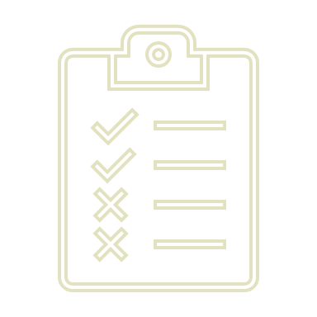
Documents
Documents
These Documents serves as a comprehensive resource to effectively kickstart a React-based project. It covers the following key areas:
The document outlines authentication, its mechanisms, LDAP authentication, Active Directory, and related processes with a code explanation.
Authentication
This document covers the necessary tools and frameworks for developing the functional requirements of the software
Functional Requirements
The document explains session handling, its lifecycle, need, management techniques, code flow, and code explanation basics
Session Handling
The document outlines security implementations, including request protection, data safety, authentication, and access control.
Security Implementation
Multi-Factor Authentication
The document highlights multi-factor authentication, its workflow, and detailed code implementation.
Keyword goes here
SonarQube Issues
It highlights SonarQube issues such as code smells, complexity, null references, and security hotspots. It also provides strategies for improving code quality and coverage.
OWASP Guidelines
The document summarizes unit testing essentials, covering types, frameworks, testing setup, API prerequisites, and test case explanations.
Click on the headings or Word Icon for the detailed documentation.

Slide 20
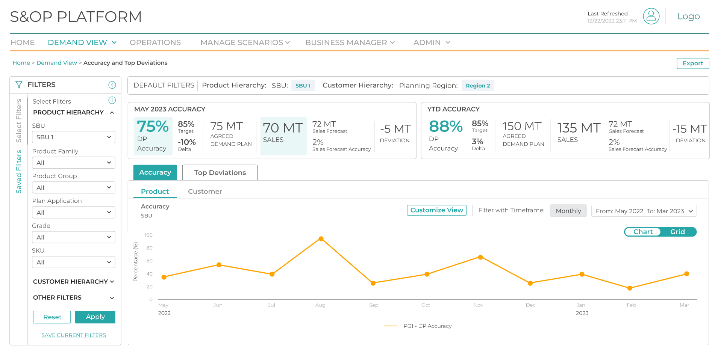
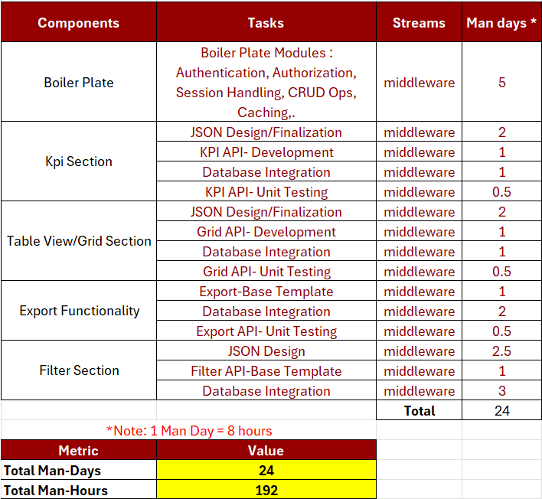

SDLC Planning Phase
Sample Effort Estimation and Resource Allocation
Design Mockup
*Tasks based on User Stories
**
Entry Criteria :
Business Goals & Objectives: Requirements document is finalized, defining clear aims, success criteria, and performance standards.
Middleware Requirements: Secure communication, API management, and data security requirements are defined to meet system expectations and regulatory needs.
**Note: Sample Effort estimation and Indicative Man Days for the Middleware project based on the above design mockup.

Slide 21

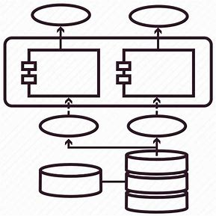


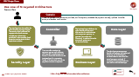
SDLC Design Phase
Sample Architecture
N-Layered Architecture
1.Security Layer
2.Controller
The security layer verifies the host, referrer, and enforces CORS policies to prevent unauthorized access. It ensures secure communication by encrypting sensitive data during transmission and decrypting it on arrival. This layer safeguards data integrity and protects against cross-origin vulnerabilities.
The controller layer processes incoming requests, validates input, and invokes the appropriate business logic. It acts as an intermediary, coordinating between the business layer and the output layer to ensure the final JSON response is accurate and formatted.
3.Business Layer
4.Data Layer
The business layer contains the core application logic, handling validations, workflows, and calculations. It acts as the decision-making hub, processing data from the data layer and passing results to the controller. This ensures a clear separation of concerns and maintainable code.
The data layer handles data storage, retrieval, and interaction with the database. It uses repositories to abstract database operations, ensuring a clean separation from business logic. This layer focuses on efficient and secure data management.
**Note : Kindly click on the Zoom chart to view the use case of N-Layered Architecture.

Slide 22






SDLC Design Phase
Use case of N-Layered Architecture
Process flow
Scenario
A user completes an e-commerce purchase, and the system processes the payment securely, updates the order status, and sends a confirmation.
The user logs into the application and submits a payment request. The security layer validates the request source and ensures compliance with security standards. It also employs fraud detection mechanisms to block suspicious activities.
Controller
The business layer validates the order details and payment information. It communicates with a payment gateway to process the transaction. Afterward, it updates the order status and generates a transaction receipt.
Data Layer
The controller receives the payment request and validates the input for completeness and format. It forwards the data to the business layer for processing. Finally, it formats and returns the payment status as a response.
The data layer saves payment details and updates the order and inventory in the database. It retrieves relevant user data like saved payment methods, if necessary. All processed data is returned to the business layer.
Security Layer
Business Layer
 | Request
 | Response
**Note : Kindly click here to know about other architectures

Slide 23
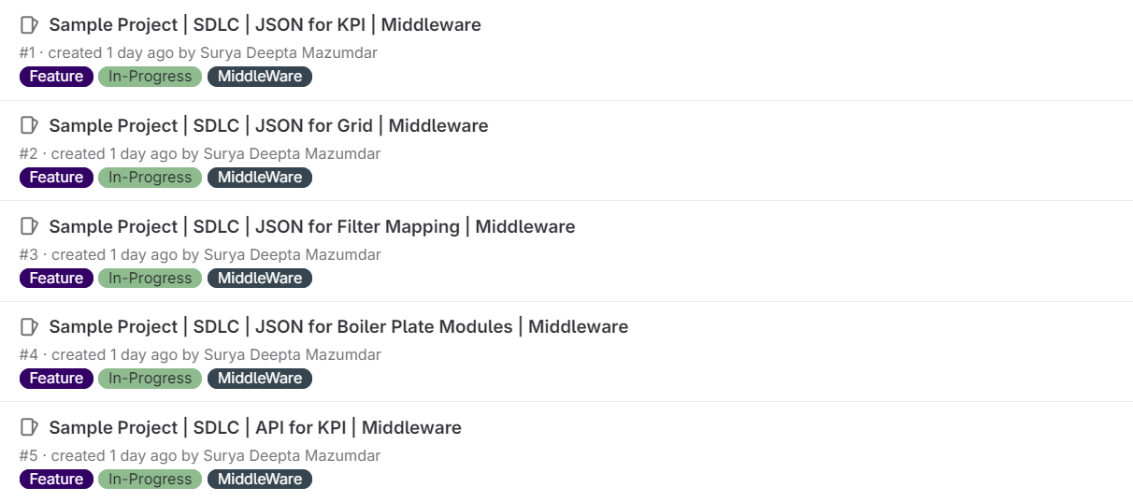
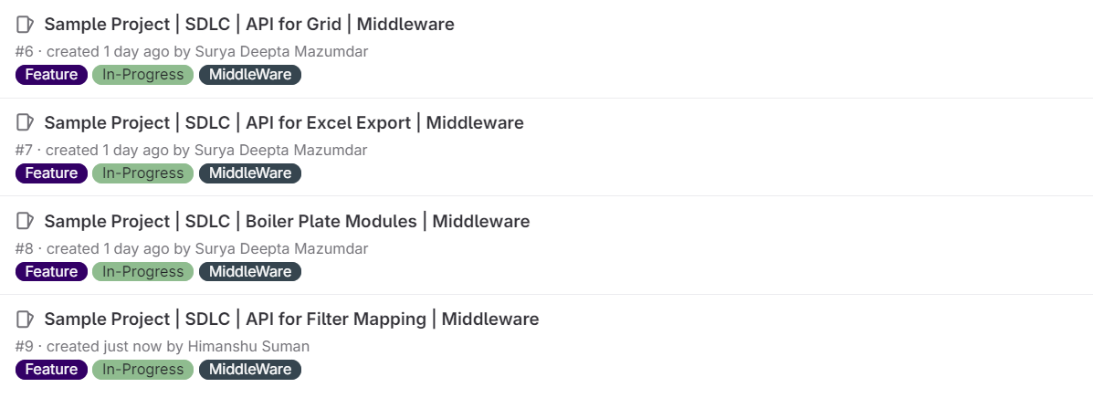
Sample Task Allocation
Development Phase
2. Assign the Issue to a Developer
In the Assignee field, assign the issue to the respective developer
Ensure the assignee has the necessary skills and bandwidth to handle the task
3. Add Milestone and labels
Set a milestone to organize tasks by project phases (e.g., Planning Phase, Development, Testing)
In the issue, select a milestone that corresponds to the task’s timeline or phase
4. Update and Organize the Issue Board
Go to the Issue Board to visualize tasks across stages (In Progress, Review, Done)
Move issues to appropriate columns based on their status
1. Create an Issue
Go to the Issues section in the GitLab repository
Click New Issue and provide a clear title and description
Note: The listed tasks are for illustrative and based on User Stories purposes and provided as examples.

Slide 24

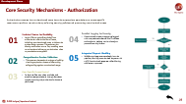
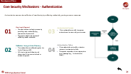
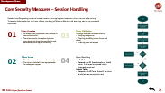
Development Phase
Core Security Mechanisms
Security mechanisms involve implementing access control, ensuring data integrity, encrypting sensitive information to protect it from interception or theft, and securing communication channels to prevent breaches during data exchange. These mechanisms play a critical role in mitigating risks and maintaining the confidentiality, availability, and reliability of systems and information. They mainly consist of:
01
02
03
Authentication
Authorization
Session Handling
Verifying the identity of a user or system to ensure they are who they claim to be
Determining whether a user or system has the necessary permissions to access specific resources or perform certain actions
Managing user interactions across requests by maintaining state information for continuity and security

Slide 25
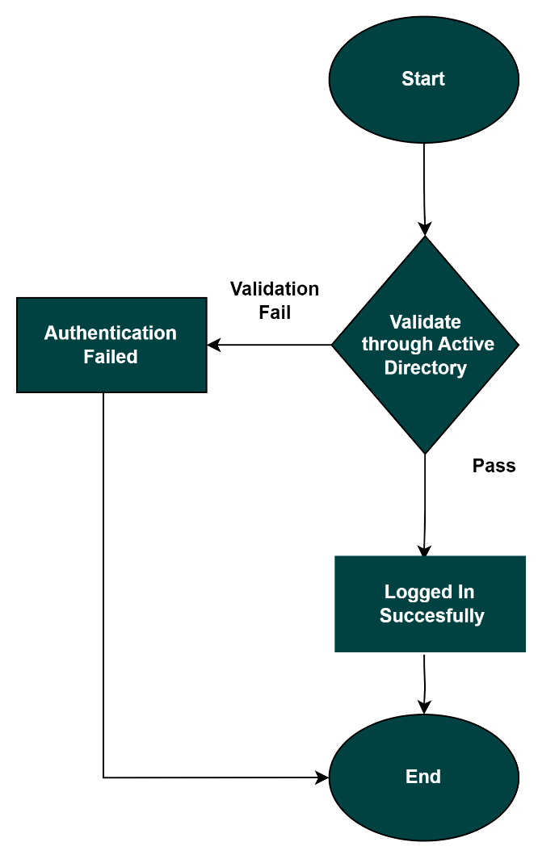
Development Phase
Core Security Mechanisms - Authentication
Authentication ensures the verification of user identity by validating credentials, granting access to resources.
01
User Login Request
The user initiates the login process by providing their credentials (e.g., username and password).
The system begins the process of validating these credentials.
03
Authentication Success
If the credentials are valid, the system authenticates the user and grants access.
Validation through Active Directory
The credentials are validated against the Active Directory (AD).
AD checks the user's identity and determines if they are authorized to access the system.
04
Authentication Failure:
If the credentials are invalid or there’s a mismatch, authentication fails.
The system responds with an appropriate error message (e.g., "Authentication failed").
02

Slide 26
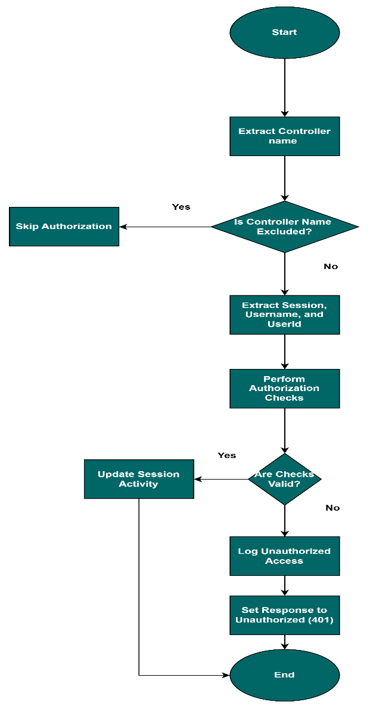
Development Phase
Core Security Mechanisms - Authorization
Authorization ensures that authenticated users have the appropriate permissions to access specific resources or perform certain actions, enforcing security policies and preventing unauthorized access.
01
Excluded Routes for Flexibility
Login APIs are typically excluded from authorization checks to allow all users, including unauthenticated ones, to initiate the authentication process. This ensures that identity verification occurs first, enabling users to authenticate before any authorization rules or permissions are applied.
04
Detailed Logging for Security
Unauthorized access attempts are logged with comprehensive details like IP address and endpoint, helping track and analyze potential security threats.
05
Integrated Request Handling
Middleware integrates seamlessly into the pipeline, blocking unauthorized requests with a 401 Unauthorized response while allowing valid ones to proceed.
02
Comprehensive Session Validation
This ensures the session is active and valid by checking expiration times and idle activity, safeguarding against unauthorized usage.
03
User-Specific Access Control
Its logic verifies user roles, modules, and screen access permissions through database queries, ensuring only authorized actions are performed.

Slide 27
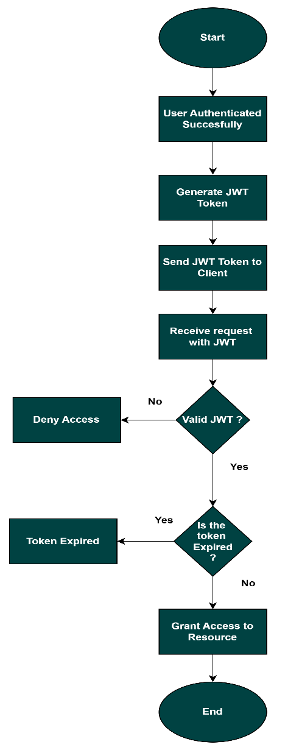
Development Phase
Core Security Measures – Session Handling
Session handling using access tokens focuses on managing user sessions without server-side storage. Tokens include expiration and user claims, enabling efficient validation and ensuring secure to protected resources.
01
Token Creation
An access token is generated upon successful user authentication.
The token contains the session expiration time, along with claims like user identity and permissions, and is signed for security.
03
Token Validation
The server validates the access token by:
Verifying its signature.
Checking its validity (correct format and claims).
Ensuring it has not expired.
02
Token Usage
The client stores the access token securely.
The token is included in the request header for subsequent requests.
04
Error Handling
Invalid Token:
Respond with 401 Unauthorized and "Invalid token" if the token is tampered with or improperly formatted.
Expired Token:
Respond with 440 Token Expired if the token is valid but past its expiration time.

Slide 28

Thank You!

